Slide 1

HOTEL
BOOKING

Slide 2


Today's agenda
Project recap
Problem
The Analytics team
Process
Insights
Summary

Slide 3

ABOUT THE DATASET
This hotel booking dataset comprises of 119,390 rows and 32 columns. The dataset describes the booking of hotels by customers. It also shows the types of customers, categories (adults, children or babies), country, the company they are from, their previous bookings and cancellations, meal type and room type requested, the market segment and distribution type, stay in week nights and weekend nights.
It also shows the hotel type, car parking space and hotel adr,
Project Recap

Slide 4



Objectives
To generate useful insights that could help the hotel management make valuable decisions on how to manage and improve the hotel.

Slide 5

The Analytics Team
Edeh, Chinonso James
Data Analyst

Slide 6


Process
1
Data Understanding
2
Data Cleaning
3
Data Modelling
4
Data Analysis
5
Uncover Insight

Slide 7

I removed the Agent and Company columns in the dataset because these columns do not really interprets much information, and also, these columns consist of lots of null rows. To get a data model suitable for data analysis, it is best to have a clean and tidy dataset.
However, I performed some few data feature engineering by creating custom columns and measures. I used the ‘adr’ column to generate the metrics for revenue in week nights and weekend nights by using the mathematical formula:
adr = revenue / stay in nights
Hence, revenue = adr * stay in nights.

Slide 8
Furthermore, I obtained the total revenue by summing the revenue for both week nights and weekend nights.
In addition, I compared the reserved room column and the assigned room column to see the number of customers that were assigned the exact room the actually reserved for. I went further to analyze how this could have an effect in the customers to repeat the patronage with the hotel.
At the end, the dataset that was previously made up of 119,390 rows and 32 columns, now has 119,390 rows and 33 columns. This was used as my Data Model for the data analysis.

Slide 9

Insights
178
Countries
221,636
Adults
12403
Children

Slide 10
Insights
949
Babies
$11,574,676.94
Revenue weekend nights
$31,148,820.59
Revenue week nights
$42,723,497.53
Total revenue

Slide 11
Analysis
There are two hotel types; City Hotel and Resort Hotel. The total revenue generated by both hotel for the period of analysis (year 2015 to 2017) is $42,423,797.53. This total revenue was calculated from the addition of week night stay of $31,148,820.59 and that of weekend night stay of $11,574,676.94 of customers ranging from 221,636 adults, 12,403 children and 949 babies from 178 different countries.
The top five most countries in terms of revenue generation are PRT, GBR, FRA, ESP and DEU. PRT topping the chart with a revenue of $14,129,138.79 followed by GBR with a revenue of $5,284,467.53.

Slide 12
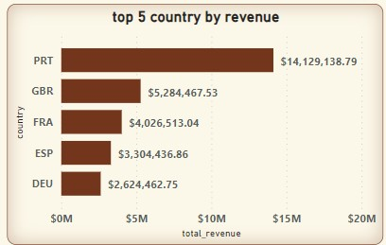

Slide 13
Analysis
In an attempt to discover factors that would cause a customer to want to repeat patronage with the hotel, I looked into the relationship between repeated customers and the customers that were assigned their reserved rooms. I noticed that the repeated customers are more of those that were assigned their reserved rooms. Among the repeated customers, 2,750 were assigned their reserved room while 1060 were not.

Slide 14
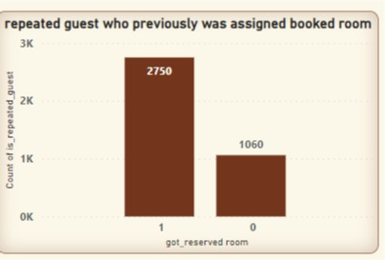

Slide 15
Analysis
I also wanted to find out if the number of car parking space affects the revenue generated by the hotel. A bar chart plot of car parking space against the total revenue shows that zero (0) space has the highest number of generated revenue with value $39,838,295.85. followed by 1 car park space with value of 2,867,644.20.

Slide 16
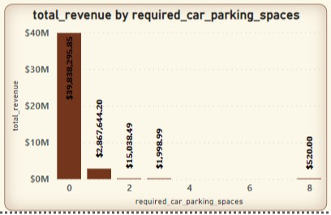

Slide 17
Analysis
In analyzing the total revenue by the hotel type, it was discovered that the City Hotel generated more revenue than the Resort Hotel. City Hotel has the value of $25,279,469.96 as against that of Resort Hotel of $17,444,027.57.
However, Resort Hotel has a higher number of babies (557) compared to City Hotel(392).

Slide 18


There are two hotel types; City Hotel and Resort Hotel. City Hotel generates more revenue than Resort Hotel. However, Resort Hotel have more of customers with babies.
More numbers of the repeated guest have had their reserved room assigned to them.
The top 5 country in terms of revenue are PRT, GBR, FRA, ESP and DEU.
Large number of the customers do not require car parking space.
Summary
&
Conclusion

Slide 19
The hotel management should ensure to assign customers their reserved rooms. This can cause the customer to want to repeat booking the hotel
The hotel has no need increasing their car parking space as most of their customers does not need car parking space.
Recommendation

Slide 20
Thank You

